Slide 1
NIELIT SUMMER INTERN 2021
COURSE:
WEB APPLICATION DEVELOPMENT USING APACHE, MYSQL AND PHP
NAME:
Gauri Khanna
PROJECT NAME:
Employee Management System

Slide 2
CODE EDITOR AND LANGUAGES USED :
Language Used - Java Core
Concept Used - Swing
IDE Used - NetBeans
Database Used - MySQL

Slide 3
FEATURES:
It has many features like:-
Home Page
Login Page
Add Employee Details Page
Employee Information
Remove, Add and Update

Slide 4
DESCRIPTION:
Employee Management System is a distributed application, developed to maintain the details of employees working in any organization.
It maintains the information about the personal details of their employees, also the details about the payroll system which enable to generate the pay slip.
The application is actually a suite of applications developed using Java.

Slide 5
SCREENSHOTS OF THE WEBSITE

Slide 6
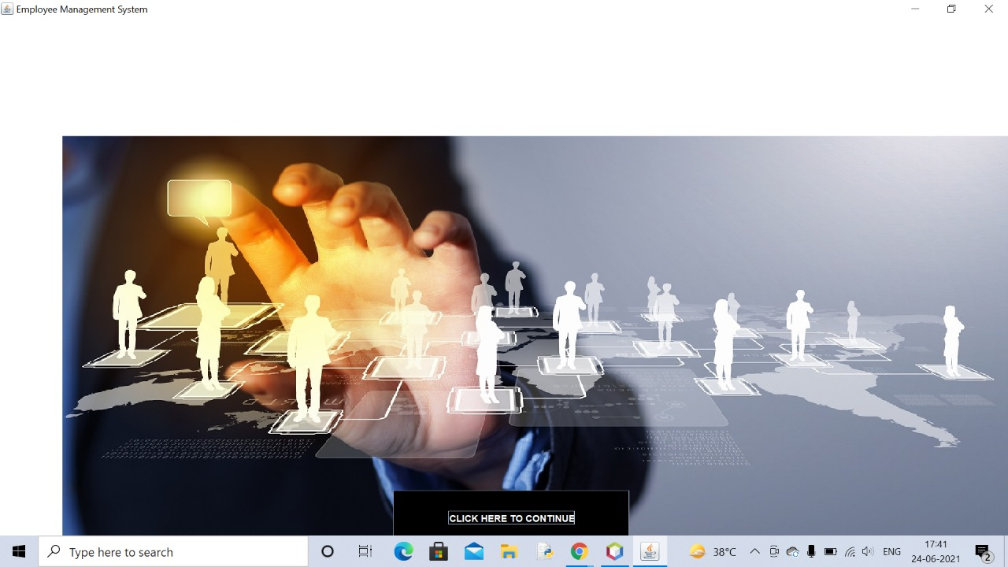
HOME PAGE : (HEADER AND BODY)

Slide 7
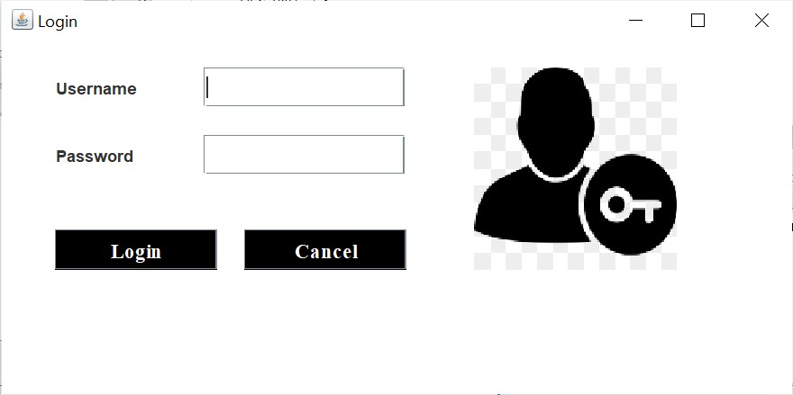
LOGIN PAGE

Slide 8
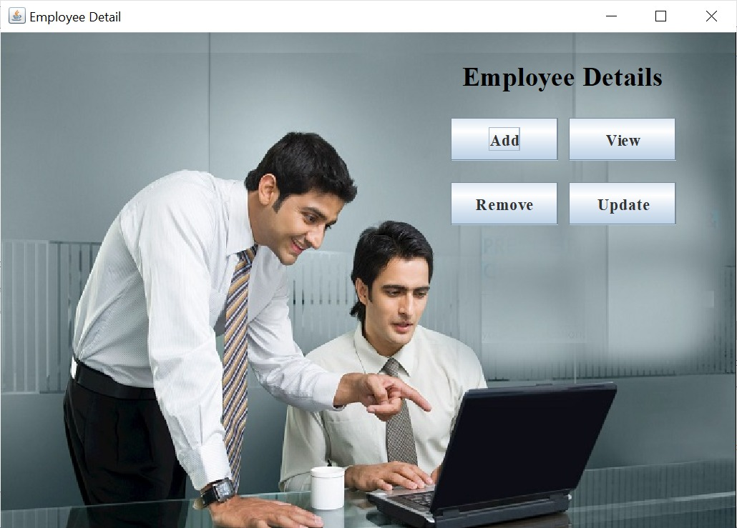
EMPLOYEE DETAILS

Slide 9
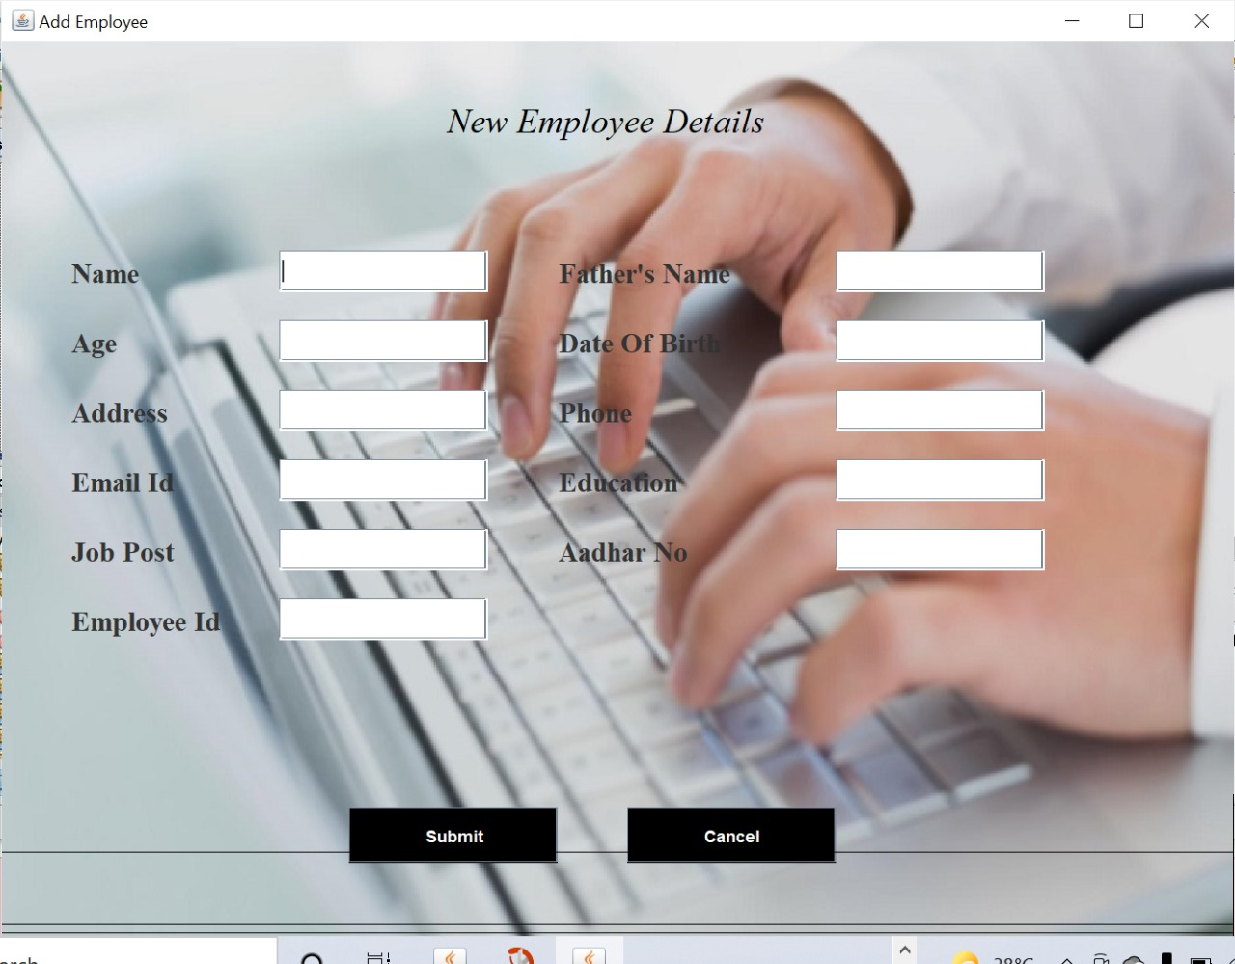
ADD EMPLOYEE:

Slide 10
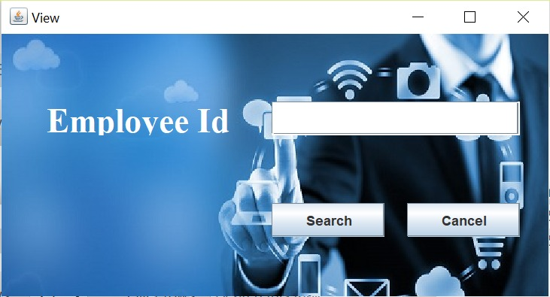
VIEW DETAILS

Slide 11
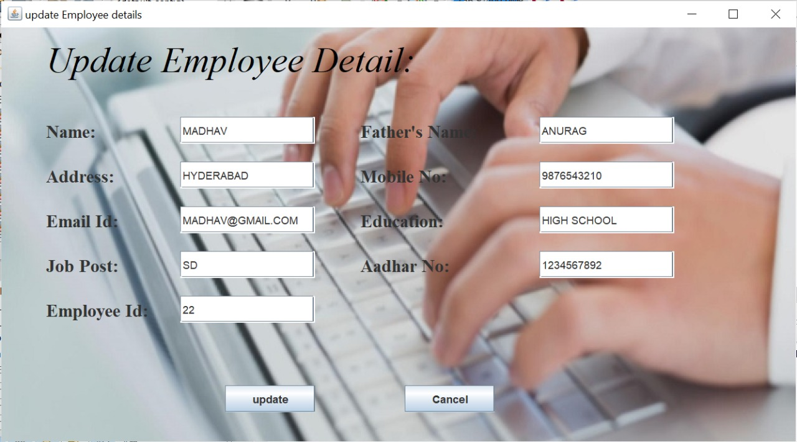
UPDATE DETAILS

Slide 12
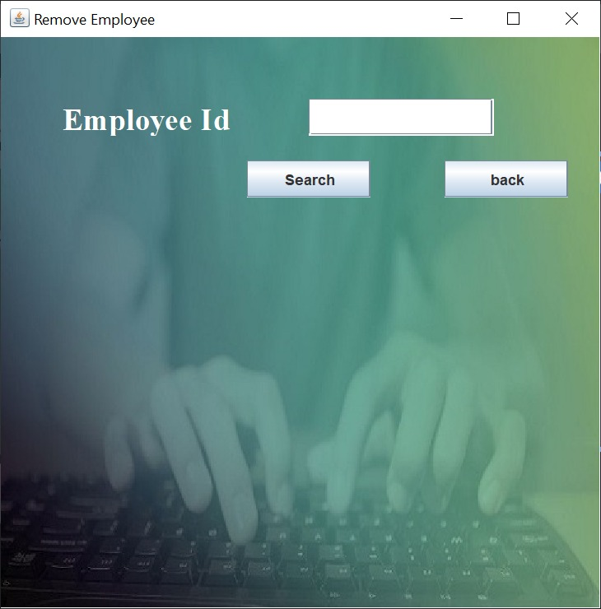
REMOVE DETAILS

Slide 13
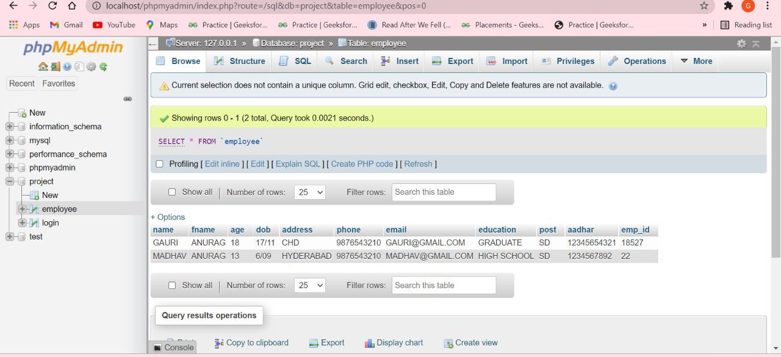
DATABASE INSERTED VALUES:

Slide 14
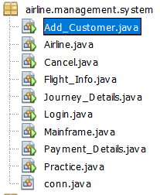
PROJECT FILES:
https://github.com/gaurikhanna1711/Employee-Management-System(SOURCE CODE FOR THESE FILES)

Slide 15
THANK YOU !

